Slide 1

HS 2015
Current Trends in Distributed Systems
Final presentation
Group:
Patrick Zumsteg
Simon Wallny
Philipp Oldenburg

Slide 2
Structure
Idea
Classification
3rd Party Libraries
HS 2015
Current Trends in Distributed Systems – Final presentation
<Nummer>

Slide 3
Idea
Weather station
  Log sensor data
    Label data points with a pre-existing weather service
  Train a classifier to tell current weather condition
  Visualize on a web page
  Stretch goal: predict weather
HS 2015
Current Trends in Distributed Systems – Final presentation
<Nummer>

Slide 4
Classification (Mid-Term)
Naive Bayes
SVM
4-dimensional feature space
  Temperature
  Wind speed
  Air pressure
  Humidity
HS 2015
Current Trends in Distributed Systems – Final presentation
<Nummer>

Slide 5
Classification (Final)
Bayes Classifier
8-dimensional feature space
  Temperature
  Wind speed
  Air pressure
  Humidity
  Δ Temperature
  Δ Wind speed
  Δ Air pressure
  Δ Humidity
HS 2015
Current Trends in Distributed Systems – Final presentation
<Nummer>

Slide 6


Classification
Training in MatLab
Classifying in Java
JMatIO
HS 2015
Current Trends in Distributed Systems – Final presentation
<Nummer>

Slide 7
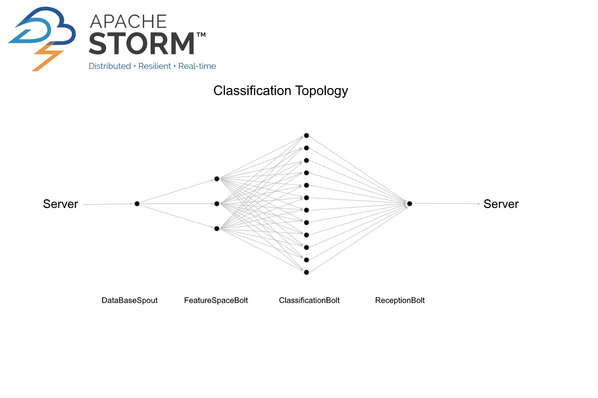
Storm Topology
ejml (Efficient Java Matrix Library)
JMatIO
HS 2015
Current Trends in Distributed Systems – Final presentation
<Nummer>

Slide 8
3rd Party Libraries
ejml (Efficient Java Matrix Library)
JMatIO
HS 2015
Current Trends in Distributed Systems – Final presentation
<Nummer>

Slide 9
Lessons Learned
Steer clear of „open weather map“
To properly train a weather classifier,
have at least one year's worth of data.
HS 2015
Current Trends in Distributed Systems – Final presentation
<Nummer>

Slide 10
HS 2015
Current Trends in Distributed Systems
Final presentation
Group:
Patrick Zumsteg
Simon Wallny
Philipp Oldenburg

